Slide 1

BABY HEART
By: Navsangeet Kaur

Slide 2

Novelty in Baby Heart
There exists a similar software which is known as heart rate and it can be found in iphones under health app. This software measures the heart rate of the user every second.
“Baby Heart” has a similarity to the above mentioned software but the quality that is novel and differentiate this software from the health app software is:
It detects the user’s heart rate as well as their unborn baby’s heartbeat.
It is incorporated in the apple watch, so while the watch is in contact with user’s skin, the software will provide the video of the heartbeat per second.
It also provide the audio of the baby’s heartbeat when the watch is in contact with the user’s stomach area.

Slide 3

Continued..
The software also let the users download and print the visual of their baby’s heartbeat.
It let the user’s download the audio of their baby’s heartbeat for later use.
The software will also display if the heartbeat is not detected so the user can take action as soon as possible and can prevent complications otherwise which can cause misscarriage.
Thus, this software presents the new technology that can make the service less-expensive and affordable to the public while bring forth at home ultrasound plus health app combine.

Slide 4

Motivation
I got the motivation to build this software because at times like this when we are in a pandemic. I have watched several videos online of pregnant women who shared their personal experience of going to the hospital.
It is important for them to stay safe so their baby will be safe.
I got an idea that “Baby Heart” system will help all the future mothers to gain a positive experience during these unfortunate times.
The software will detect the baby’s heartbeat and provide visual and audio of it so the mothers can save it.
“Baby Heart” can help users detect unusual activities to prevent miscarriage. Also, let the users know if the heartbeat is not detected so they can rush to the hospital for immediate treatment/solution instead of waiting for the regular checkup to find out the abnormalities/complication s in their pregnancy.
It is portable so the users can have access to wherever they go.

Slide 5
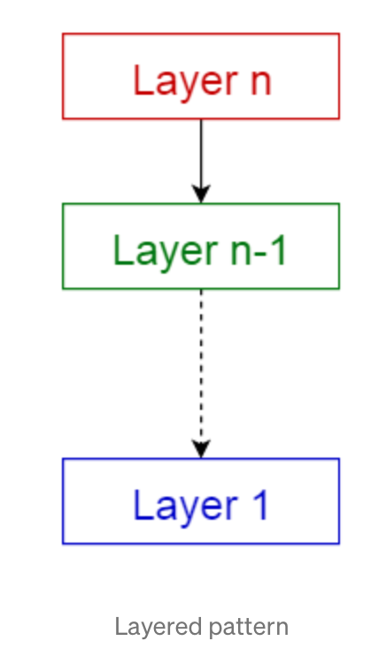
Architectural Patterns
Layered Pattern: Describes a generic Baby Heart layered monitoring architecture that we have developed to capture the key elements and structural components. These include the main processes involved, the underlying platforms, and the main actors and their involvement in the Baby Heart-based monitoring processes.The architecture is organized into four horizontal connected layers and one vertical silo on the right in addition to important properties that have to be supported across all layers including security fulfillment, Quality of Service (QoS) enforcement, and smartness integration. It includes google cloud UML, cloud computing, cloud storage, and storage. The system supports remote monitoring.
Numbering the lowest to highest layer from 1 to 4 respectively. The 1st layer consists sensing platforms such as mobile sensor, LED device, Holter monitor, and transducer to detect the heartbeats. The 2nd layer consists of sinus rhythm detection, noise and heartbeat filtering. The 3rd layer includes simulation, deep learning, and machine learning. And the 4th layer includes visual and audio displays, activity alert, and heart rate monitoring.

Slide 6
“Baby Heart” presents the architecture as a series of views; use case view, logical view, process view and deployment view.
Use Cases represents some significant, and central functionality. It also describes the set of use cases that have a substantial architectural coverage, and illustrate a specific, delicate point of the architecture.
Baby Heart use cases are:
- Register for an account & Login: This use case describes how a user logs into
the system. The actors starting this use case are mothers.
- Maintain personal health information: This use case allows the users to maintain personal information in the system. This includes adding, modifying, and deleting information from the system.
- View visual heartbeat record of the user as well as unborn baby: This use case allows the user to view her and her baby’s visual heartbeat record from previous days or months.
- View audio of the baby’s heartbeat: This use case allows the user to view her baby’s audio heartbeat record from previous days or months.

Slide 7
Logical view concerned with the functionality that the system provides to end-users. It is comprised of 2 main packages:
- User Interface: It contains classes for each of the forms that the actor use to communicate with the System. Boundary classes exist to support login, maintaining personal info, viewing visual heartbeat records, and viewing audio heartbeat records.
- Business Services: It contains control classes for interfacing with the controlling user registration of an account, and managing the user records.
Process View: It describes the tasks involved in the system's execution, their interactions and configurations.The Process Model illustrates the classes organized as executable processes. Processes exist to support user registration and functions, and get records.
Development view: It describes the various physical nodes for the most typical platform configurations. Also describes the allocation of tasks (from the Process View) to the physical nodes. This includes Baby Heart node which is central node and has threads to log device, heartbeat display, audio display, network interface which is connected to the network server, record printer and heartbeat detectors which gives out processing and memory storage.

Slide 8
Size and Performance
Quality
The user interface of the Baby Heart System shall be designed for ease-of-use and shall be appropriate for a computer-literate user community with no additional training on the System.
Each feature of the Baby Heart System shall have built-in online help for the user. Online Help shall include step by step instructions on using the System. Online Help shall include definitions for terms and acronyms.
The system shall be available 24 hours a day, 7 days a week. There shall be no more than 4% down time.
Mean Time Between Failures shall exceed 300 hours.
The software architecture supports the key sizing and timing requirements.
The system shall support up to 2000 simultaneous users against the central database at any given time, and up to 500 simultaneous users against the local servers at any one time.
The system shall provide access to the record database with no more than a 10 second latency.
The system must be able to display heartbeats every second.
The recording and saving portion shall require minimum 2TB RAM.

Slide 9
Patterns for Object Oriented Design
Context model: This model conveys the system boundaries, which means what lies inside and outside the system. Baby Heart system uses activity diagram, the system confirms if two heartbeats are detected, record it in the system and report to the system. Then the system decides between two option if the heartbeats are detected at two different rates and are differentiated, it will record the visual of the heartbeat as well as audio of the baby’s heartbeat using LED device and transducer respectively, otherwise display that the other heartbeat is not detected and consult to the doctor. Thus, when the case goes out to the hospital that lies outside the system.
Structural model: This model shows the organization of the system and discusses the flow and design of the architecture. It uses class diagrams that have 1-1, 1-many, and many-many relationships between the classes. In the Baby Heart system, mothers personal info class has 1-1 relationship with with class mother. It contains name, doctor info, current pregnancy month, delivery due date, health conditions, and clinic/hospital.
Behavioral model: The model conveys what happens and what is supposed to happen when the system responds to stimuli from its environment. It uses data-driven, and event-driven models. If the data shows that the heartbeat of a baby is not detected or abnormal heartbeat is detected then the system displays that no second heartbeat or abnormal heartbeat respectively is detected and tells the user to consult doctor. As for event-driven model, if mother gets into unusual situation physically, then the system will display the information to the user.
Interaction model: This model reveals the communication between the users and the system. It uses sequence diagram that shows the interaction between the user and the system. The user make an account to get an access to the system and then personal information input by the user is used by the system. The data gained from the users body through the system is used to display the output such as a message or the visual and audio of the heartbeat.

Slide 10
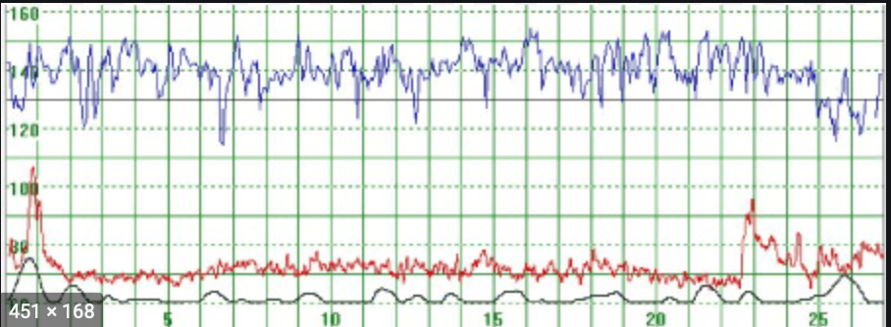
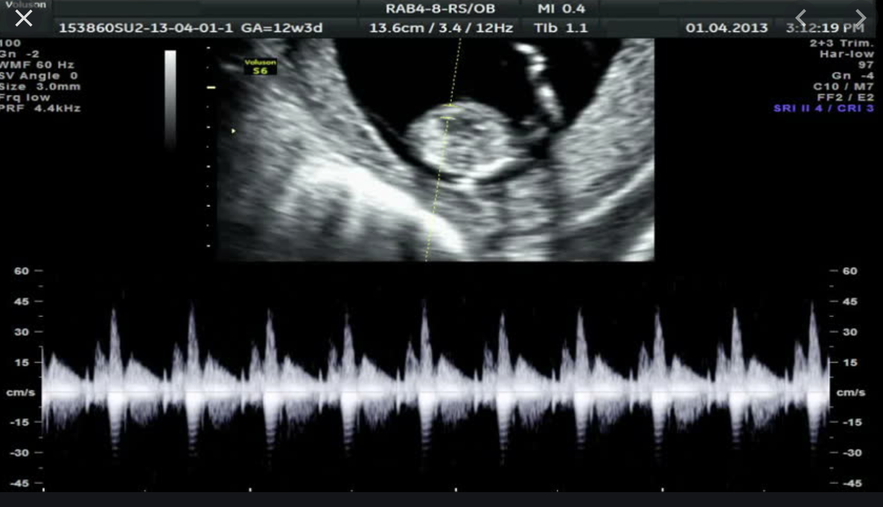
Implementation
Sample Output
The sample output that the system will produce is the visual heartbeat waves of the mother which is 80-90 beats/minute as well her baby.
The second output that the system
will produce along with the visual is the audio of the baby’s heartbeat per second.
Otherwise,
The system will display message “No heartbeat detected” in case of the baby’s heartbeat is not detected which should be about 80-85 beats per minute the first month, 120-180 beats/minute in the mid-pregnancy, and 175 beats/minute during the beginning of 9th month.
OR, the system will display “abnormal heart rate, consult doctor” when the baby’s heartbeat drops or increases than normal.
The implementation went well. I made a implementation plan structure which includes list of project tasks such as documentation, architecture and design, implementation, testing, outputs, and improvements. It also includes priority tasks and indicate the milestones tasks.
The tasks have the dates that indicate starting and ending dates for specific tasks and the actual completion date, and tasks status. Firstly, I gathered ideas, collected business requirements, and prepared project charter that includes the background of the similar system, objective and goals of the system, budget and resources, and project scope.
The above structure plan helped me to do the implementation accurately without missing any tasks and have the specifics in mind and prevent scope creep.

Slide 11
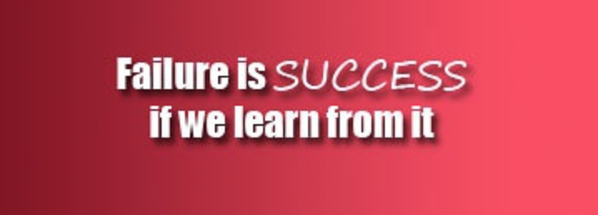
Accomplished
Failure
Improvement
I succeeded in getting the outputs that I expected when the data was detected as well as when the data was missing of both mother and the fetus.
Also, the data was available for viewing as well as downloading and printing.
Moreover, the system was available remotely so the system, data, record, and information could be accessed anywhere.
I failed in fitting the whole output of 9 months in the storage.
The other thing is the unavailable hardware.
The things I would want to improve are:
The capacity of the output.
The hardware I needed for
the watch such as LED device, and transducer
The system of transducer should be integrated in small device so it could be incorporated in the apple watch for the user.

